Slide 1
Movie Ticket
Booking System
Under Guidance of :
Prof.P. S. Gholap

Slide 2

D.Y.Patil College of Engineering and Technology, Kolhapur.
Presented by :-
Atharva Kale (56)
Amar Pawar (51)
Atharav Jadhav (58)
Omkar Kamalakar (63)
Pranav Mane (60)

Slide 3
01
Overview To the Project.

Slide 4
Overview
As the name suggests this system is used for Booking tickets.
It provides convenient means for booking seats for users.
It is implemented for single screen with different rates according to seat type.
A user can book a ticket , view now playing movies.
Admin of system can add movies , delete movies , view transactions of customers.
It also contains validation for the inputted user information.

Slide 5
02
Aim and Objective of the system.

Slide 6
Aim and Objective
To create another way for the customers to Buy Movie ticket , get information about the Movies.
Aim
To provide the customer the complete information of the movie.
Customer can view all the Movies,book the tickets hence providing developed portability and excel flexibility..
Objective

Slide 7
03
Control Flow Diagram.

Slide 8
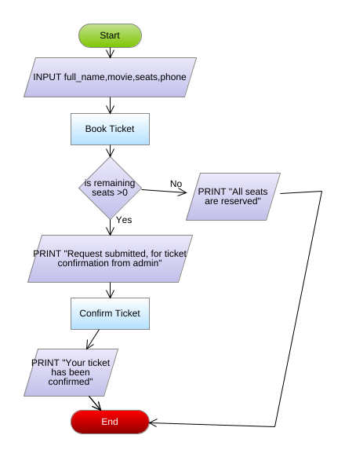
Control Flow Diagram

Slide 9
04
Data Flow Diagram.

Slide 10
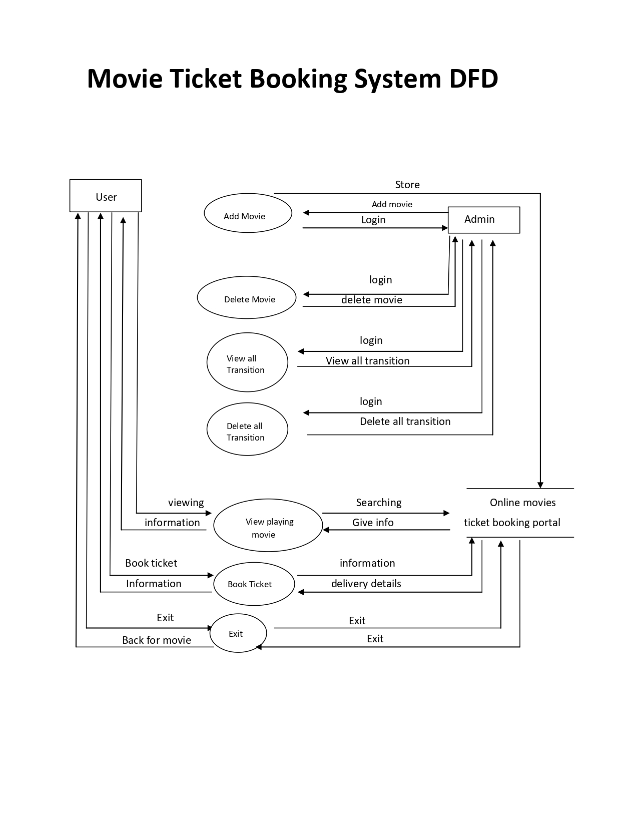
Data Flow Diagram

Slide 11
05
Features

Slide 12
Features
Add a Movie
01
02
Delete the Movie
View Transactions of Customers
03
04
Delete Transactions
Book TIckets
05
06
View now playing movie
An ADMIN Feature which allow viewer to see the current movie.
ADMIN only Feature which helps Admin to delete the current movie and add next movie.
Delete the transaction of customer.(ADMIN only)
Show All transaction of Customers.(ADMIN only)
USER feature to allow user to book ticket.
USER feature that shows user the current playing movie

Slide 13
06
Overview of the features.

Slide 14
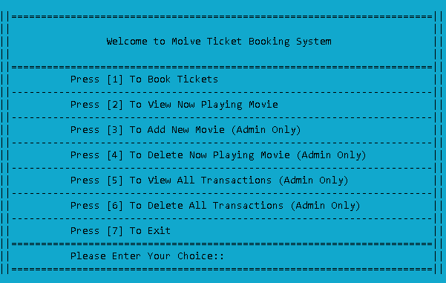
Overview of the features.

Slide 15
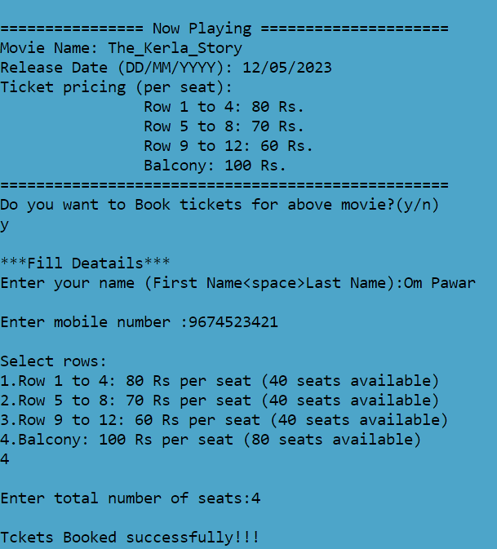
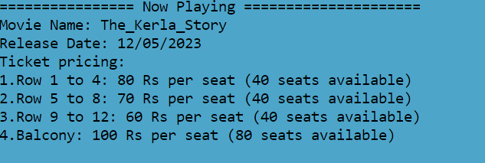
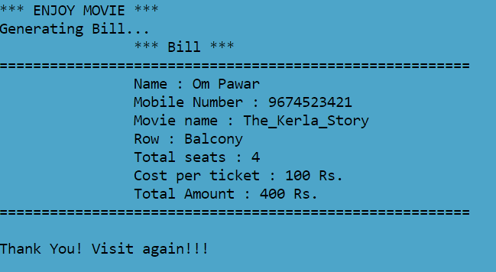
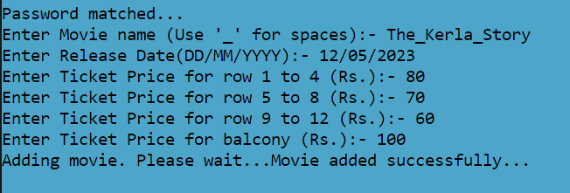
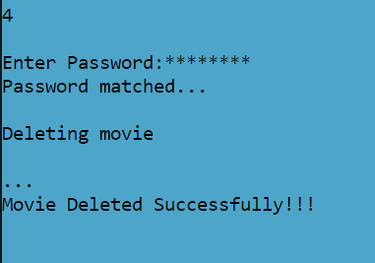
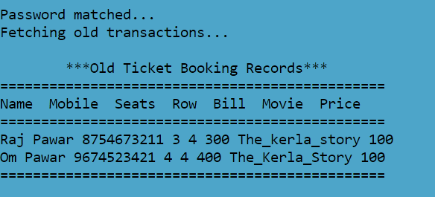
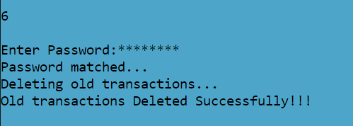
Added Features

Slide 16
07
Project Requirements

Slide 17
Project Requirements
Software Requirement
Concepts Used :
1. Windows 10
2. Language : C language
3.Compiler :VS code Compiler
4.CodeBlocks
Structure
File Handling
CLI Text colour
Switch case
Functions

Slide 18
08
References.

Slide 19
References
Data Structures With C By Schaum Lipschutz
Let Us C By Yashavant Kanetkar: Edition 13th
https://github.com/
https://stackoverflow.com/
https://www.geeksforgeeks.org/
https://www.w3schools.in/c-tutorial/

Slide 20
Conclusion.
This Project allows user a convenient means of booking of a Movie Ticket. Also it gives the Admin complete control over the administration of the system and his business. The modules are designed such a way that admin and user can only access their own operations which provides security. By this project we learn much more of file handling and concepts about c.

Slide 21
ThankYou!

